Slide 1

Optimizing User Engagement: A/B Testing
Unveiling Device-specific Click Trends and Testing Hypotheses for Enhanced User Experience
1

Slide 2

Business Case
Our A/B test seeks to improve the overall performance of our platform by delving into user behaviour and concentrating on important metrics like clicks.
Our goal is to maximize user pleasure and engagement by making well-informed judgments by comprehending the minute details of user interactions across various platforms

Slide 3
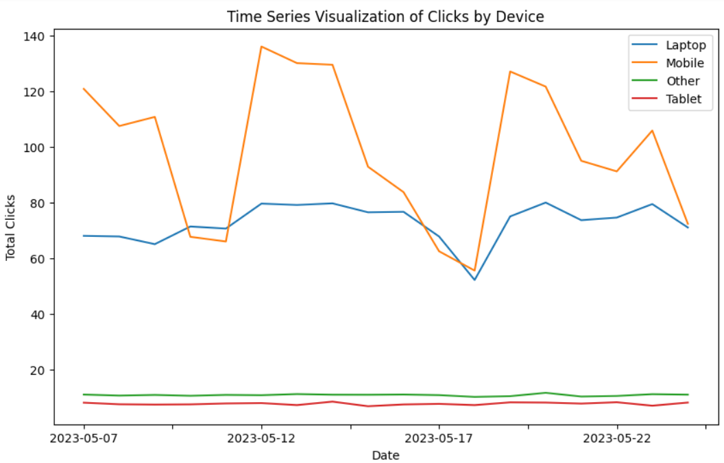
Device-wise Click Trends
User Engagement trends for different devices

Slide 4
Hypotheses
Hypotheses
Null Hypothesis (H_{o})
Alternative Hypothesis (H₁)
There is no significant difference in click rates between the Control and Experiment groups for different devices.
We anticipate a significant difference in click rates between the Control and Experiment groups for different devices
Significance Level (α)
Set at 0.05 for a 95% confidence level, ensuring reliability of our conclusions.

Slide 5
Sample Size Calculation
Initial dataset size: 18099 observations provided a robust starting point for our A/B test.
Assumptions, including a Minimum Detectable Effect (MDE) of 3%, a significance level () of 0.05, and statistical power of 80%, guided the calculation of an optimal sample size.
Calculated sample size: 3100
Calculations done

Slide 6
Test Result Summary
Summary of test results
The A/B test results were inconclusive, leading to an indeterminate outcome.
This suggests that, based on the observed data, we cannot confidently conclude whether there is a significant difference in click rates between the Control and Experiment groups for different devices.
Further analysis and exploration are warranted to uncover additional insights and inform subsequent iterations of our user engagement strategy.

Slide 7




Thank You
Ajay Singh Mehta
+91 7078364711
ajay.mehta332005@gmail.com

